Slide 1
Austrian Drug Market and
Early Warning System
Charlotte Klein
14.11.2024

Slide 2
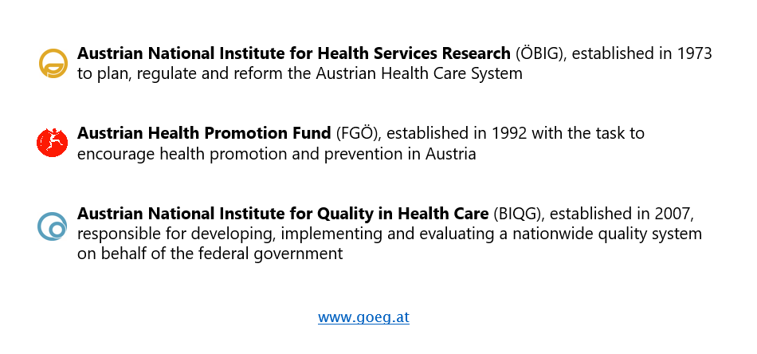
The Austrian Public Health Institute (GÖG)
Who are we?
Notes:
3 integrated Business units
Multidisciplinary teams consisting of Biologists, economists, physicians, psychologists, socio-epidemiologists, statisticians, media worker, prevention experts, lawyers, nutrition experts, urban and regional planners
230 persons working (190 VZÄ)

Slide 3
GÖG - Addiction Competence Centre
Since 1995 the REITOX Focal Point of the European Drug Agency (EUDA) is located at the Austrian Public Health Institute.
Competences concerning alcohol, tobacco, illegal drugs and gambling have been brought together.
National data monitoring centre in the field of addiction (e. g. data collection on treatment, opioid maintenance treatment, drug related deaths, alcohol and Tabaco consumption, general population surveys)
According to our holistic approach not specific substances are problematic but the addictive behaviour (regardless to which behaviour or substance).
Determinants and Circumstances leading to addiction or preventing addiction and harm reduction are seen as very important aspects.

Slide 4
The illegal Austrian Drug Market according to crime data, treatment data and drug-checking
Who? (population)
Where?
Pattern of use (what)?
General Population Survey
European Web Survey
Crime report data (Narcotic
substance act violations)
Treatment Data (TDI, „DOKLI“)
Drug-Checking
Drug-related deaths

Slide 5
Drug Situation Austria: Crime reports 2022
Source: Crime reports relating to violations of the Narcotic Substances Act, by narcotic drug/substance 2022 BMI/BK; N= 34,000
graphic representation: GÖG

Slide 6
Drug Situation: Treatment Data 2022
Source: Austrian treatment information system DOKLI. N= 27,133; graphic representation: GÖG

Slide 7
Drug Situation Drug Checking: Checkit! 2023
Source: Checkit! Drug Checking Jahresbericht 2023 - checkit!; N= 2, 429; graphic representation: GÖG
*Cannabinoids only tested if synthetic cannabinoids suspected

Slide 8
The Austrian Early Warning System
Information concerning new substances or newly consumed substances; impurities or other uncommon circumstances, new or especially risky patterns of consumption
To establish an official network for information
To provide reliable and timely information on health risks for prevention and treatment.
To include all relevant institutions and experts.
To establish an advisory board with experts from different areas, who provide advice in critical situations but also on strategic issues.
To disseminate information received from the EUDA/European EWS to national partners
Notes:
Federal ministries (health, interior, defense, justice ...)
Drug/addiction co-ordinations and public health authorities at regional level
Drug facilities (outpatient, inpatient, outreach, low threshold, selective prevention etc.)
Emergency departments and forensic medicine
Representations of medical doctors, pharmacies, ambulance services, social/health insurance
Others (youth services, hospitals, GPs involved in substitution treatment ...)
Special experts as member of the advisory board

Slide 9

Data Sources
Seizures
(only NPS)
Drug-Checking Services
(Vienna, Innsbruck, Graz)
Drug-related Deaths
(1 year delay)

Slide 10

Legal Framework
New-Psychoactive Substances Act (NPSG) since 1.1.2012:
Users of NPS will not face any penalties; Selling NPS
could entail imprisonment from one to ten years,
generic law
The Narcotic Substances Act (valid version SMG; Federal
Collection of Statutes BGBl I 1997/112) Based on international
conventions. Use ruled as Offence (misdemeanor or
felony). Separate provisions for cannabis and
hallucinogenic mushrooms. Focus on a wide range of
alternatives to punishment.
Notes:
I asked AI to create a picture of a downhill spiral and it came up with this rather psychodelic happy version of it. I thought it might fit this meeting today but it is still a rather dangerous spiral. Once you regulate a new substance its trafficking becomes illegal and new substances will be developed and created. Creating newer substances with unknown risks. Creating new health risks.

Slide 11
New Psychoactive Substances: Drug-Checking 2023
Source: Austrian EWS; N= 802; graphic representation: GÖG

Slide 12
New Psychoactive Substances: Austria EWS 2023
Source: Austrian EWS N= 1,049 graphic representation: GÖG

Slide 13
Summary: The illegal Austrian Drug Market
„General Population“
Recreational Use
Cannabis/Cannabnioids
Stimulants (Cocaine,
Amphetamines)
Possible threats
Synthetic
Cannabinoids
Edibles
Clubbing/Party Setting
Often combined use
Stimulants (Cocain,
Ecstacy,..)
Ketamine
Possible threats
N20
Synthetic Cathinones
High Risk Drug Use
Polydrug Use
Opioids major role
High benzodiazepine use
Possible threats
New Synthetic Opioids
(e.g. Nitazene)

Slide 14
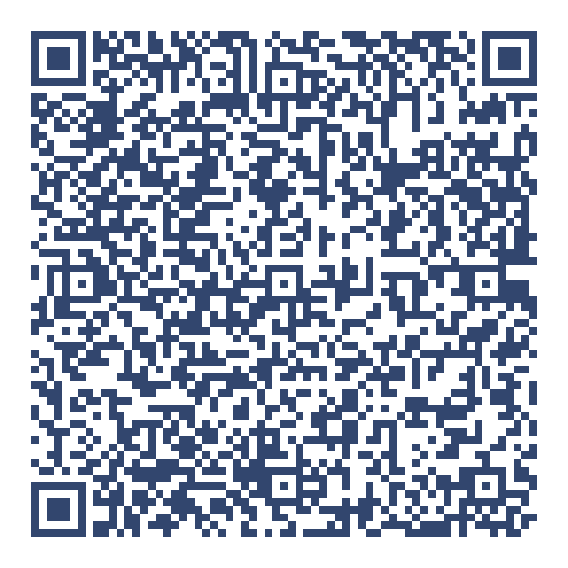
Contact
Further reading:
https://jasmin.goeg.at/id/eprint/3371
https://jasmin.goeg.at/id/eprint/3369

